Slide 1


Bringing Balance Back to The Credit
Peyton Hampton, Campbell Jessop, Alissa Gordon, and Sam McFarland

Slide 2
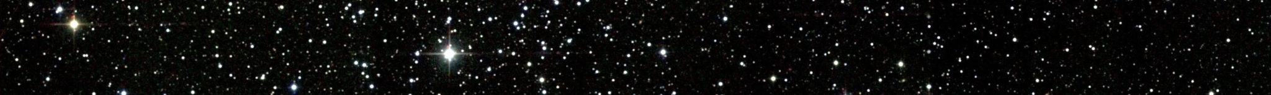
Introduction/ Goal Of Model
Goal:
Accurately predict the next 12 months of Imperial Credit
Situation:
Our analysts have been taken captive
It is up to us to defend our credit against the rebels

Slide 3
Summary of Data
Credit has been growing steadily each month
Credit is in Millions
492 Data Points

Slide 4

Model Selection
A high RMSE (Root Mean Squared Deviation) shows how far off our residuals are.
It is the “Typical Miss” of the model.
The lower the RMSE-the better
The Arima 013 Model selected has an RMSE of 0.0923.

Slide 5

How Do We Know Our Model is Good?
We use a method called Cross Validation to test each model
Cross validation trains our model with limited data
The model is then tested on data that it has not yet seen
This process is repeated over and over again

Slide 6
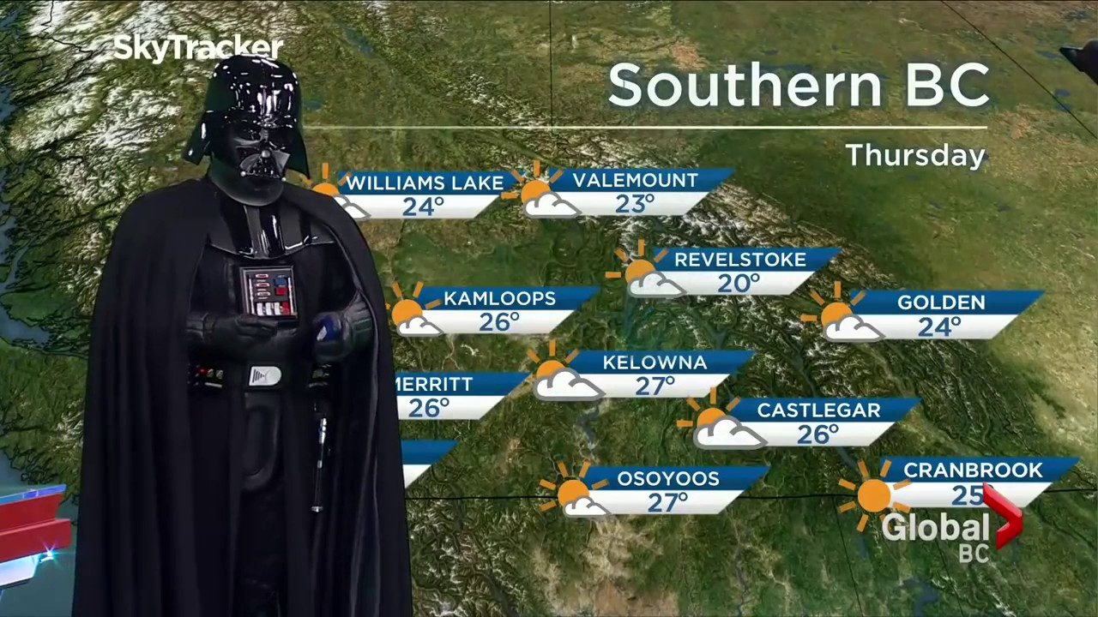
Model Forecasts
5/1/22 | 6/1/22 | 7/1/22 | 8/1/22 | 9/1/22 | 10/1/22 | 11/1/22 | 12/1/22 | 1/1/22 | 2/1/22 | 3/1/22 | 4/1/22
1.89 | 1.9 | 1.89 | 1.89 | 1.89 | 1.89 | 1.89 | 1.89 | 1.89 | 1.89 | 1.89 | 1.89
Monthly predictions of imperial credit in millions

Slide 7
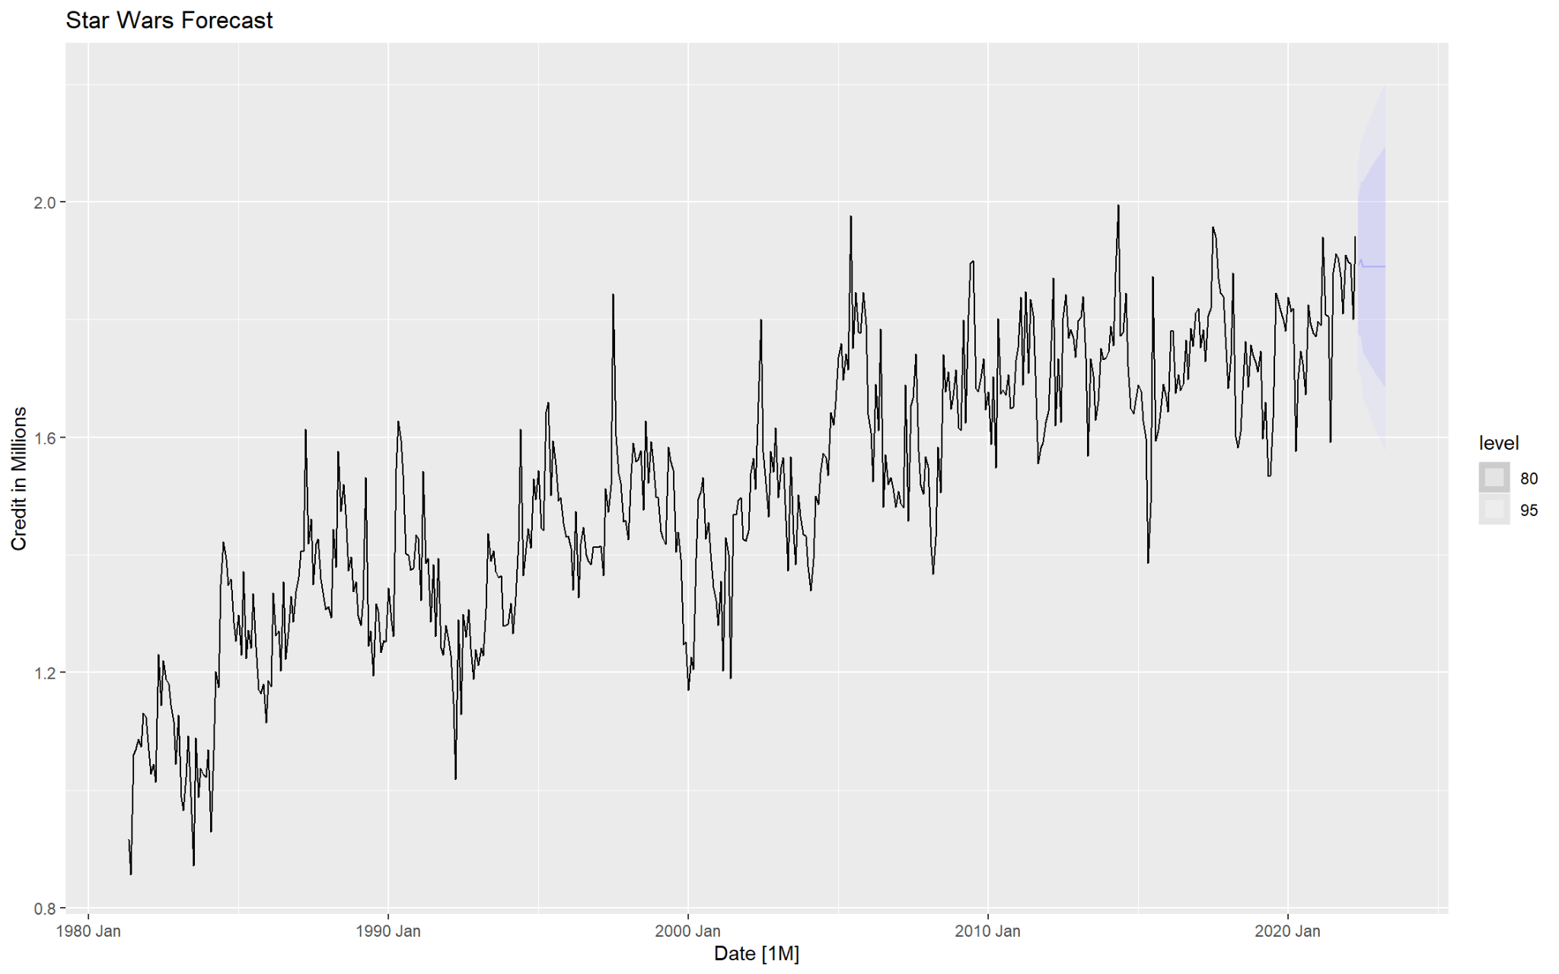
Monthly Forecasts
We can be 95% confident that the future credits will fall in the shaded lighter shaded area.

Slide 8


May the Empire Emerge Victorious!

Slide 9
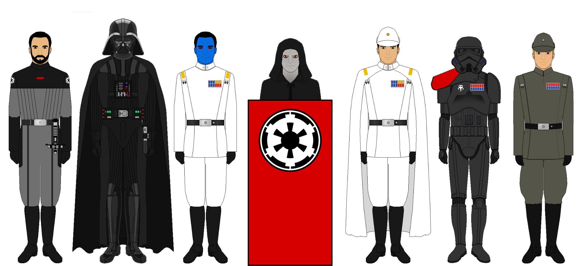
Appendix

Slide 10
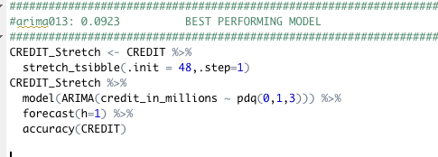
Our Model Code

